Slide 1

Overpass Turbo

Slide 2

We will work with Overpass-Turbo
Web-based interface to query the Overpass-API
You can:
Select/filter OSM data
thematic ➔ tag based
spatial ➔ bbox; object based
temporal/historic
user
Martin Raifer
extract / export
improve OSM data quality
Create simple web/static-Maps

Slide 3
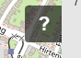
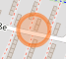
How to find the tag(s) used for which object?
https://wiki.openstreetmap.org/wiki/Map_Features
The osm wiki is there to help you
https://taginfo.openstreetmap.org/
very good resource with statistics on every key
provides a map to see in which parts of the world is the tag used
links to wiki page
http://tagfinder.herokuapp.com/
fancy search on top of the osm wiki
http://wiki.openstreetmap.org/wiki/Category:Tags
the landing page if you google e.g.: „osm <autobahn>“
Your desired object is still not included in the results?
➔Check the tag with the
Identify Tool in Opentreetmap

Slide 4
When to use Overpass-turbo?
You want OSM data?
specific objects on a regional level?
different specific objects on a locale level(e.g city)?
temporal/user based changes up to a regional level?
➔ Overpass is what you are looking for
lots of objects for a large area?
better go for an export tool or dump it yourself
Other cool Stuff in overpass-turbo:
find missing information
find bad mapped objects
overlapping
highlight objects, share it as clickable map or static .png
use permalinks to create dynamic webmaps

Slide 5
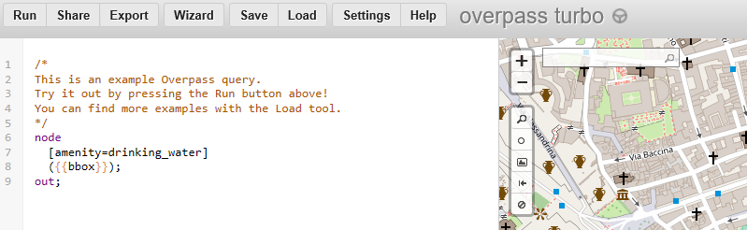
Interface
run your query([ctr]+[enter])
Export your results
save/load queries in/from your browser
Here you find helpful links like:
project wiki
query syntax wiki
..and much more
Wizard – creates the syntax for you
(see slide <X>)
get a permalink to your query/results
e.g. change display language
your query syntax goes in here

Slide 6
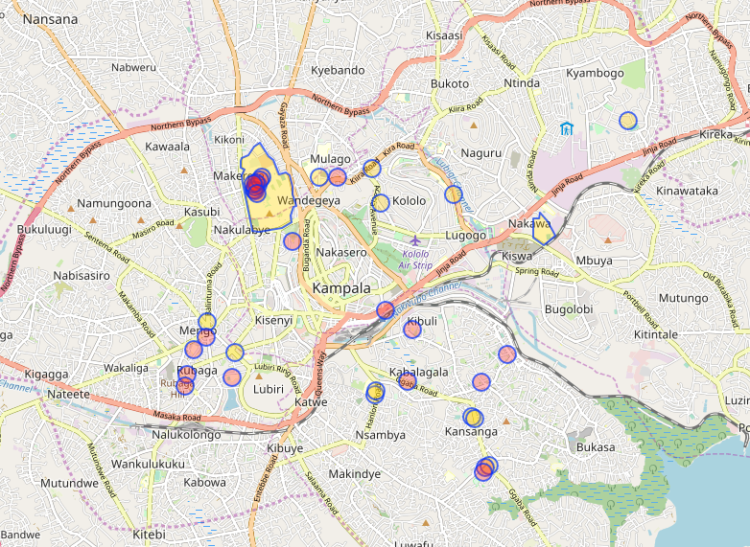
Select/Filter by tag try it yourself
Lets start with an easy query ➔ filter all objects which are associated with university
[out:json];
(
node["amenity"="university"]({{bbox}});
way["amenity"="university"]({{bbox}});
relation["amenity"="university"]({{bbox}});
);
out body;
>;
out skel qt;
http://overpass-turbo.eu/

Slide 7
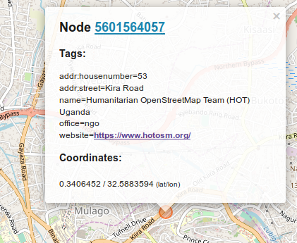
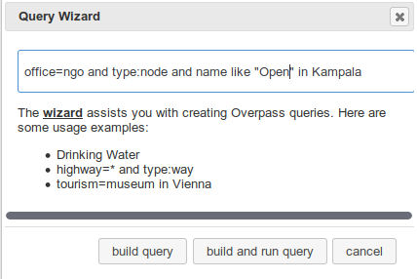
Query wizard wizard wiki
QL Syntax? Is there an easier way?
- yeah go for the Wizard
search tags and types
logical operators to combine AND OR
define an area of interest with in
use like or not like to define ranges of values, you are looking for

Slide 8
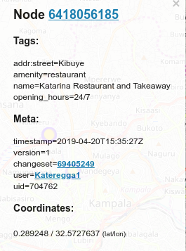
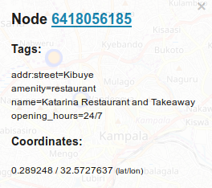
Want more information? – Get meta data!
try it yourself!
At the bottom line of your code:
change out body; TO out meta;
);
// print results
out body;
>;
out skel qt;
);
// print results
out meta;
>;
out skel qt;
);
// print results
out meta center;
>;
out skel qt;

Slide 9
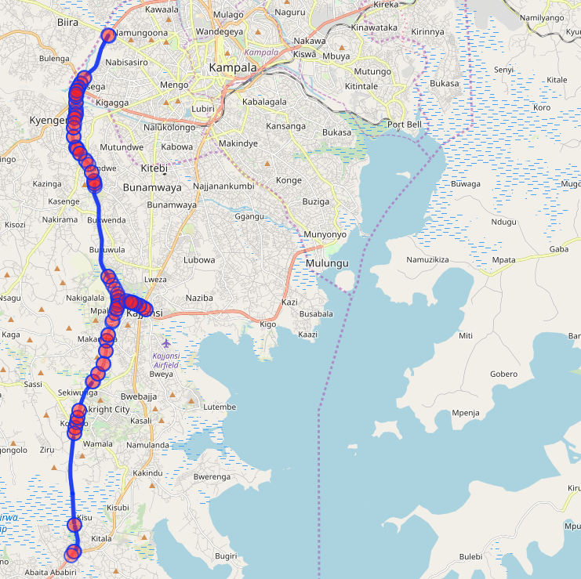
Motorways in Uganda try it yourself
[out:json][timeout:25];
// fetch area “uganda” to search in
{{geocodeArea:Uganda}}->.searchArea;
// gather results
(
// query part for: “highway=motorway”
node["highway"="motorway"](area.searchArea);
way["highway"="motorway"](area.searchArea);
relation["highway"="motorway"](area.searchArea);
);
// print results
out meta;
>;
out skel qt;

Slide 10
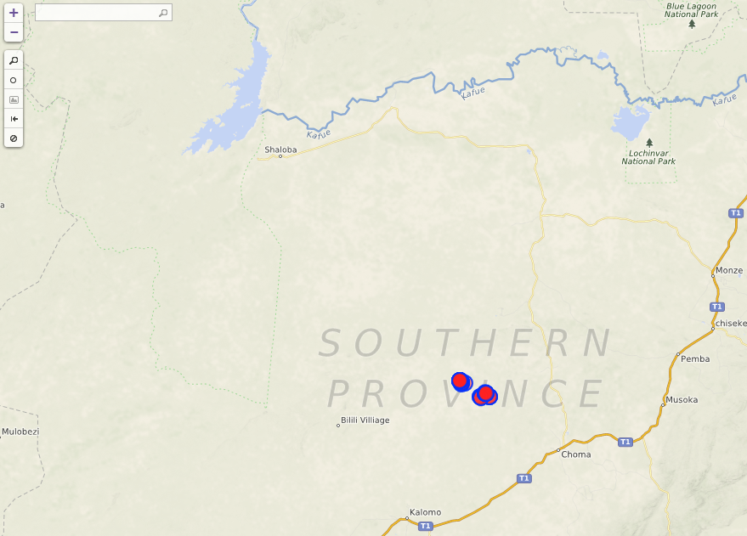
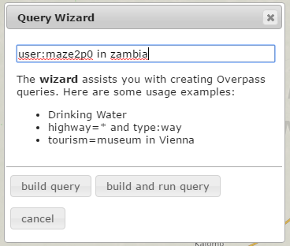
Filter by username try it yourself
[out:json][timeout:25];
// fetch area “zambia” to search in
{{geocodeArea:zambia}}->.searchArea;
// gather results
(
// query part for: “user:maze2p0”
node(user:"maze2p0")(area.searchArea);
way(user:"maze2p0")(area.searchArea);
relation(user:"maze2p0")(area.searchArea);
);
// print results
out meta;
>;
out skel qt;

Slide 11
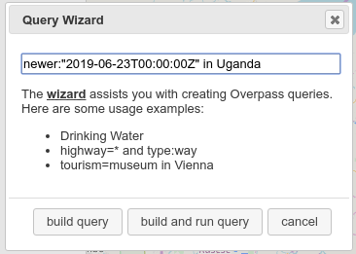
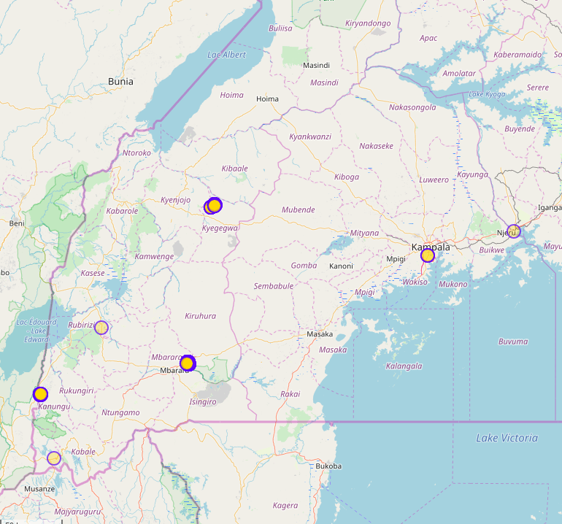
Filter by time – newest objects try it yourself
[out:json][timeout:25];
// fetch area “Uganda” to search in
{{geocodeArea:Uganda}}->.searchArea;
// gather results
(
// query part for: “newer:"2019-06-23T00:00:00Z"”
node(newer:"2019-06-23T00:00:00Z")(area.searchArea);
);
// print results
out meta;
>;
out skel qt;

Slide 12
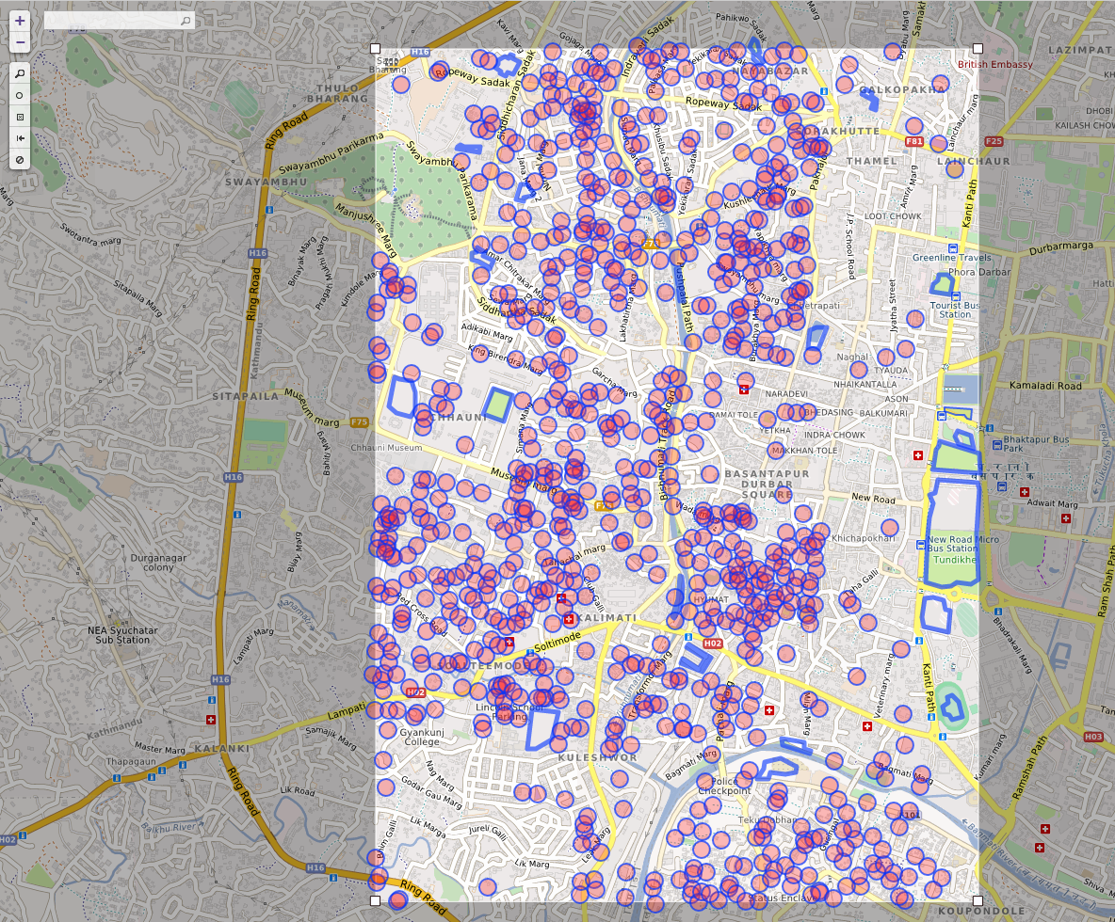
Filter by time – historic objects try it yourself
visualize data which was created until a specific date
idp camps Kathmandu after
before 05/05/15
[out:json][timeout:25][date:"2015-05-20T00:00:00Z"];
// gather results
(
// query part for: “"idp:camp_site"=spontaneous_camp”
node["idp:camp_site"="spontaneous_camp"]({{bbox}});
way["idp:camp_site"="spontaneous_camp"]({{bbox}});
relation["idp:camp_site"="spontaneous_camp"]({{bbox}});
);
// print results
out meta;
>;
out skel qt;

Slide 13
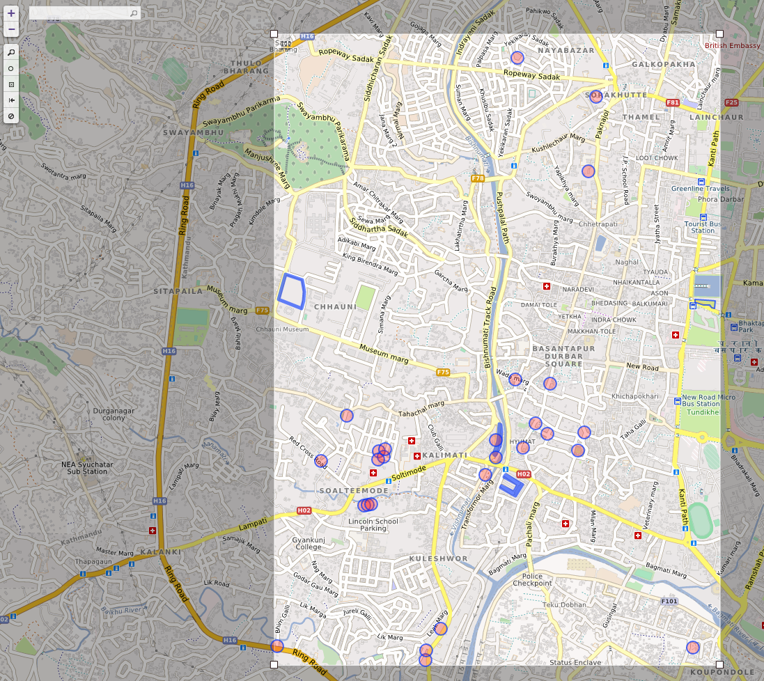
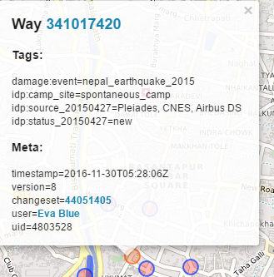
Filter by time – historic objects try it yourself
objects created after that specific date
[out:json][timeout:25];
// gather results
(
// query part for: “"idp:camp_site"=spontaneous_camp and newer:"2015-05-20T00:00:00Z"”
node["idp:camp_site"="spontaneous_camp"] (newer:"2015-05-20T00:00:00Z")({{bbox}});
way["idp:camp_site"="spontaneous_camp"] (newer:"2015-05-20T00:00:00Z")({{bbox}});
relation["idp:camp_site"="spontaneous_camp"](newer:"2015-05-20T00:00:00Z")({{bbox}});
);
// print results
out meta;
>;
out skel qt;

Slide 14
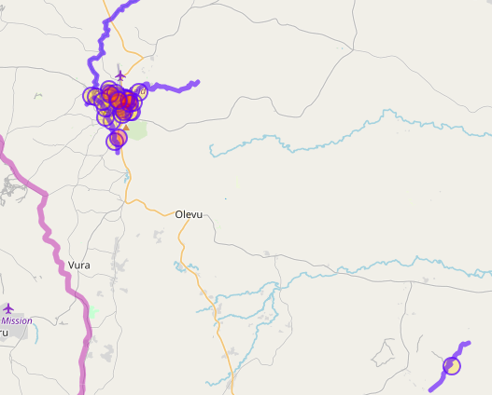
Simple distance analysis of flood prone schools try it yourself
[..]
( way[amenity=school](area.searchArea);
node[amenity=school](area.searchArea);
rel[amenity=school](area.searchArea);
)->.schools;
// find waterway=* around schools with radius 100m
way(around.schools:200)[waterway]->.waterways;
// get schools in 200m distance for all identified waterways
( node.schools(around.waterways:200);
way.schools(around.waterways:200);
rel.schools(around.waterways:200);
)->.matchingSchools;
// return results, schools and waterways
(.matchingSchools; .waterways;);
out geom;

Slide 15

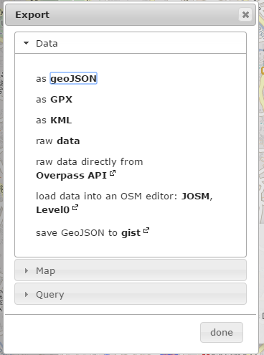
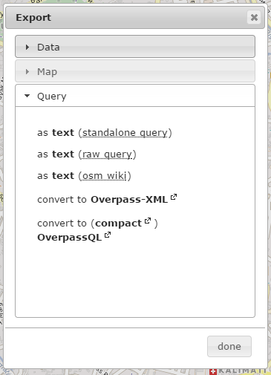
Export your results
Query:
[Save] will store the query in your browser storage
[Export]>>[Query] will export your query to a local file. Alternatively copy paste the content from the editor to a text editor program like notepad
Data:
Several formats, but no shapefile
If you want to use the data in a Desktop GIS go for geoJSON

Slide 16
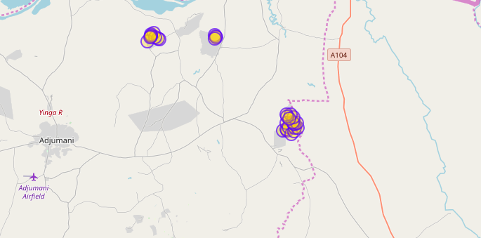
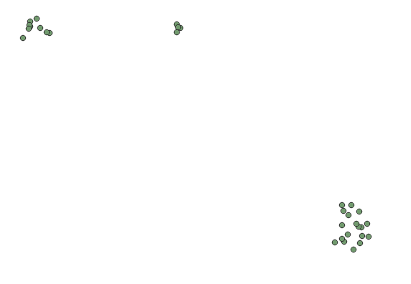
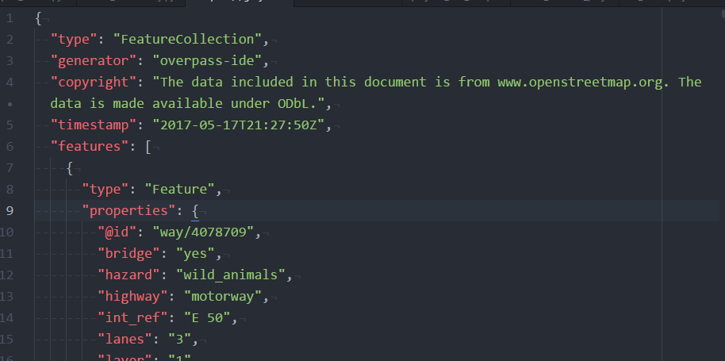
Export of water points in Adjumani
try it yourself
run the query
click on [export]>>[geJSON]
a file export.geojson will be downloaded
just drag and drop it into QGIS
structure of geojson

Slide 17
Create a dynamic Map using uMap
https://umap.openstreetmap.fr/de/
create fancy collaborative webmaps
upload spatial data
create layer
you can use your OSM Account to get access
import OSM Data via Overpass-turbo query as link
➔ it will be dynamically queried everytime the map is loaded

Slide 18
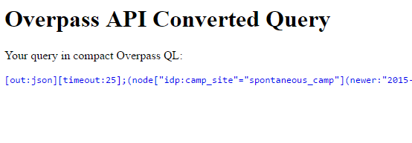
Export your query as Link try it yourself
example: Hospitals in Kenya
export your query as compact OverpassQL
right click on the query link and copy the address

Slide 19
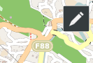
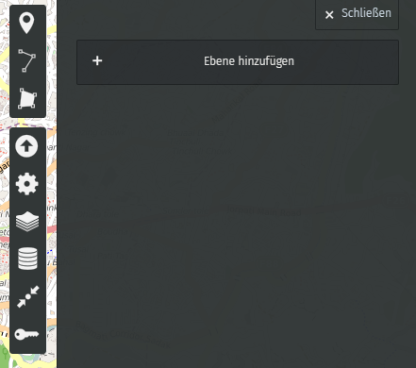
(1) integrate your results in uMap tutorial
[create new map]
make it editable by clicking on the pen in the top right corner
go on with the database symbol
create a layer

Slide 20
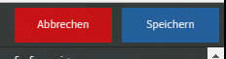
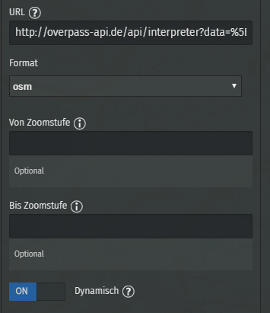
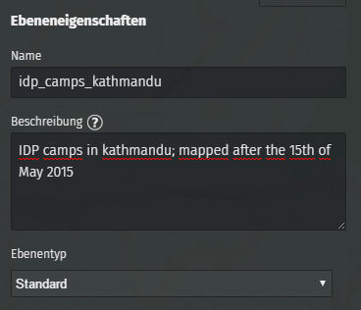
(2) integration your results in uMap tutorial
Give your layer an appropriate name and describe it
Go to [Remote Data] section
paste your query URL
Tick the dynamic checkbox
click [save] in the top right corner

Slide 21
http://overpass-api.de/api/interpreter?data=[out:json][timeout:25];(node["amenity"="hospital"]({south},{west},{north},{east});way["amenity"="hospital"]({south},{west},{north},{east});relation["amenity"="hospital"]({south},{west},{north},{east}););out;(._;>;);out;
With Nodes only
http://overpass-api.de/api/interpreter?data=[out:json][timeout:25];(node["amenity"="school"]({south},{west},{north},{east});way["amenity"="school"]({south},{west},{north},{east});relation["amenity"="school"]({south},{west},{north},{east}););out body center;(._;>;);

Slide 22
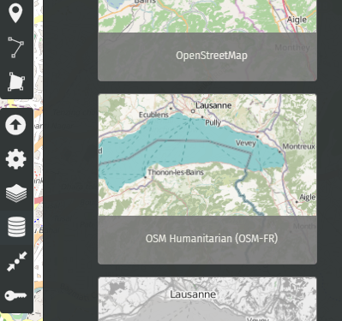
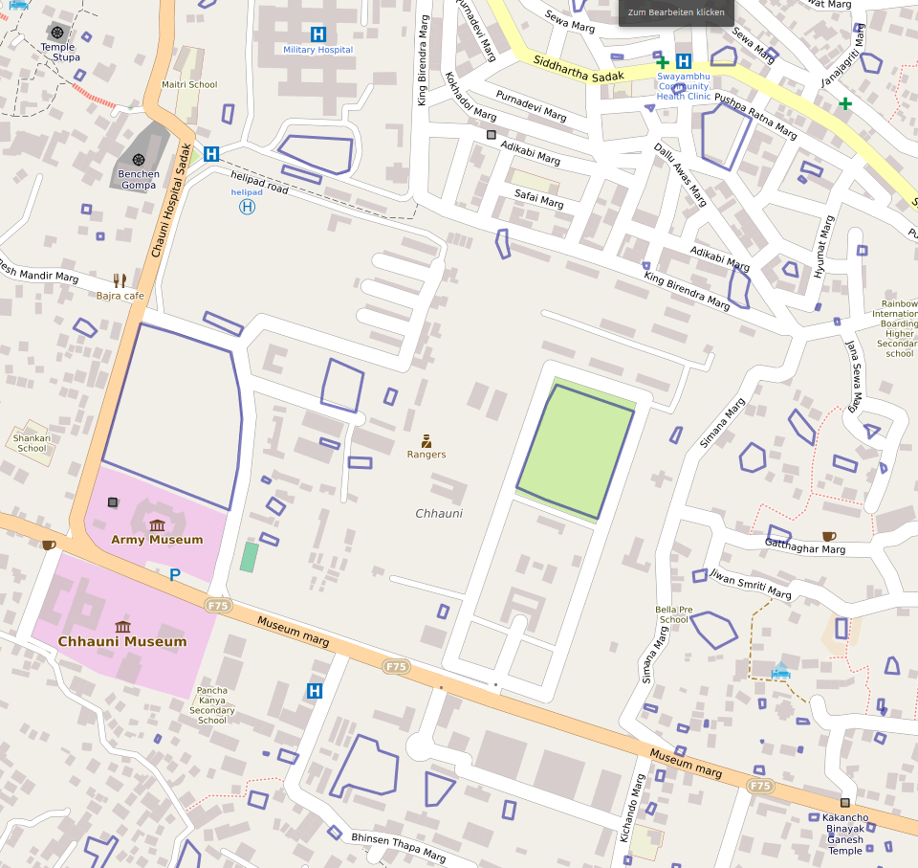
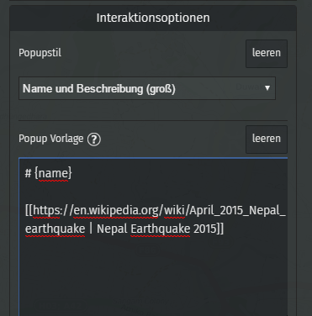
(3) integration your results in uMap tutorial
Your results now appear in umap
customize your map
different background layer
Change tile layers
Save centre and zoom
share your map

Slide 23
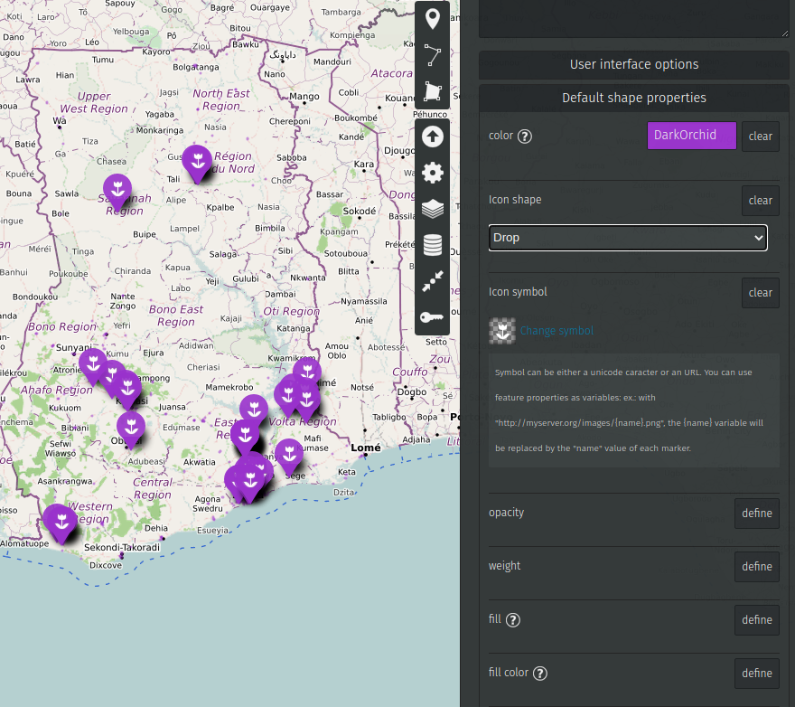
(4) Customise your map tutorial
Show labels
Settings -> Properties -> Interaction options -> Display label
Icon shape and color
Settings -> Shape properties - > Color, Shape, Symbol

Slide 24
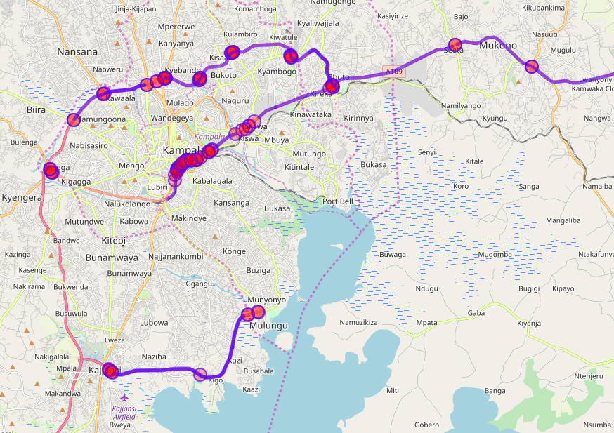
Find missing speed limit try it yourself
Ask not what OSM can do for you, ask what you can do for OSM
[out:json];
{{geocodeArea:uganda}}->.searchArea;
(way["highway"="motorway"][!"maxspeed"](area.searchArea); way["highway"="primary"][!"maxspeed"](area.searchArea););
out body;
>;
out skel qt;

Slide 25
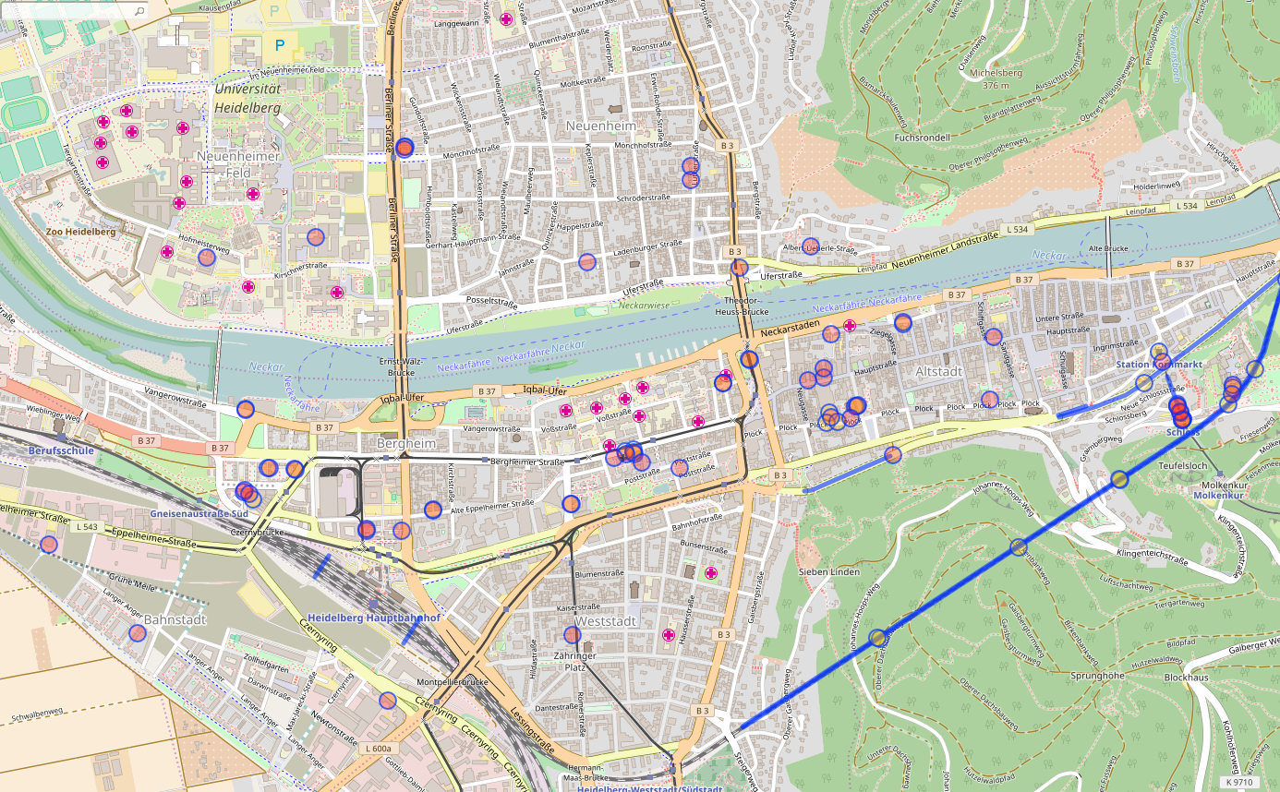
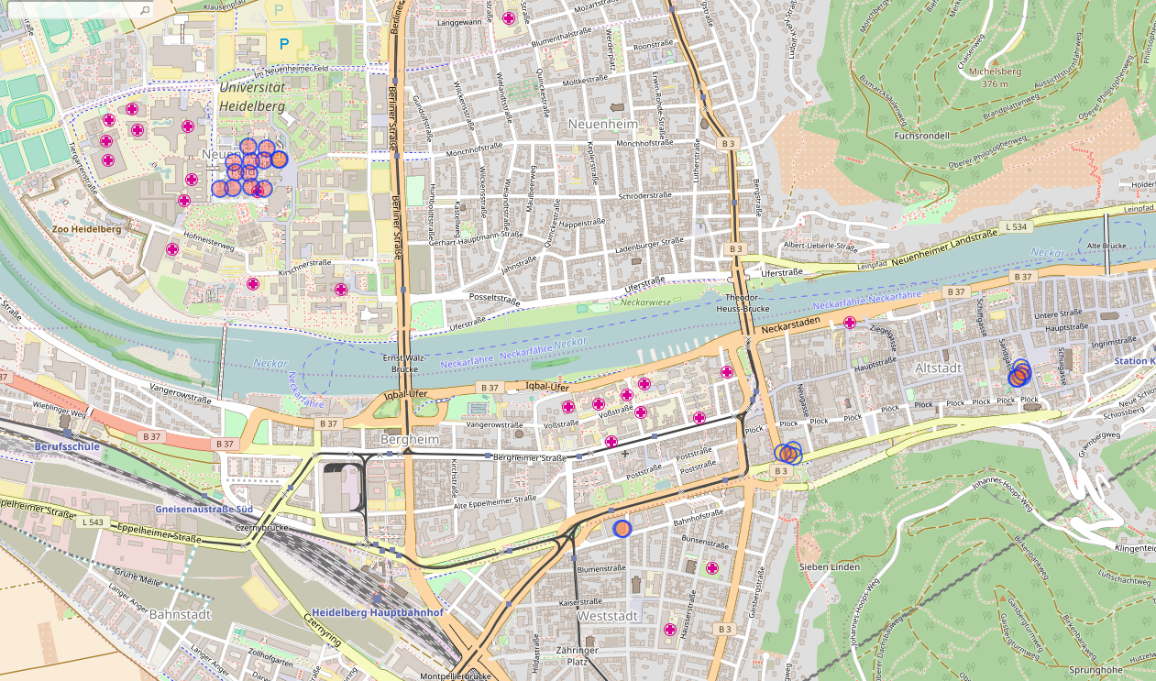
Find missing tunnel heights try yourself
(
way["tunnel"]["tunnel"!~"no"][!"maxheight"][!"waterway"]["highway"!~"steps"]["highway"!~"footway"]["highway"!~"path"]({{bbox}});
);
(._;>;);
out meta;
tunnels with maxheight

Slide 26
Additional resources
Language Guide
Overpass API Examples
Python library to run Overpass queries by Franz-Benjamin Mocnik
More on tags:
https://wiki.openstreetmap.org/wiki/Humanitarian_OSM_Tags
https://taginfo.openstreetmap.org/

Slide 27
More Maps from HOT
HOT Interactive maps repo
Lookup lit and unlit boreholes in Arua + Yumbe
Lookup child friendly places

